Slide 1
CrowdTrack – rAPP
Autonomous Networks
Sireen Malik 08/27/2026
Sireen Malik Jan 23rd, 2026APP -

Slide 2
.Crowd-following uplink beam management rApp
1
The problem
2
The goal
3
The success test
A dense sector has 5 uplink beams pointed at fixed azimuths. Per-beam UE counts arrive every second. The rApp must decide where to point the fan next, and when to widen or split it.
Turn the base model into a rApp that reads per-beam counts and emits one JSON object: fan_center, tilt, action, reason. Nothing else. Every second. Deterministic.
On a held-out tick, the trained model returns valid JSON, within schema bounds, matching the count-weighted centroid. Formatter tool stays on as the safety net either way.
Inference is one second cadence, temperature 0. Loop stays gated by a Python policy engine.

Slide 3
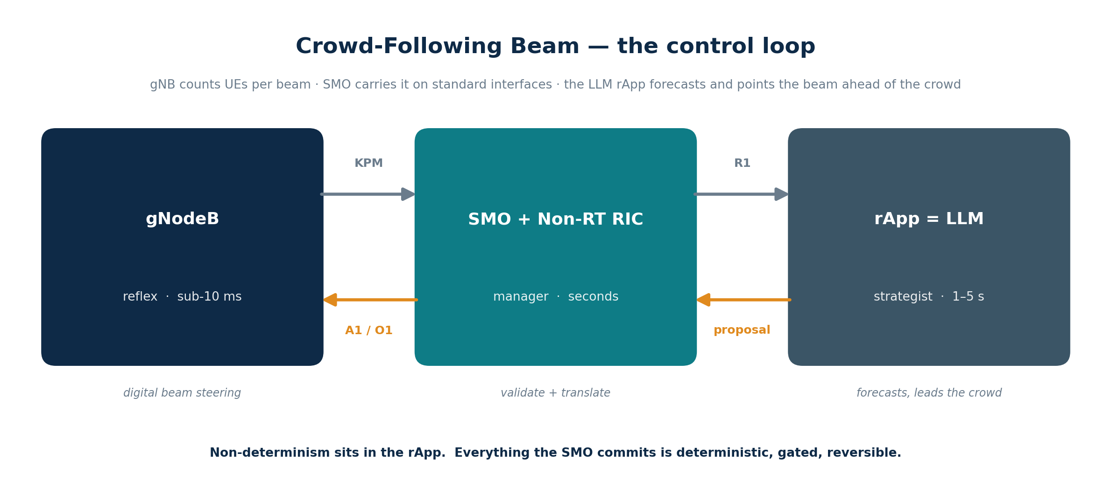
CrowdTrack rAPP
An LLM rApp that points the uplink beam ahead of a moving crowd
1

Slide 4
Why the base model was not enough
The model knew the concept. It could not hold the contract.
BASE MODEL, PROMPTED
BASE MODEL + LoRA, VALUES ENVELOPE TO TOOL
Based on the beam counts, I think the crowd is moving to the right, so we should shift the fan. Here you go:
{"beam_target": 40, "reason": "move towards crowd"}
{"fan_center": 40, "tilt": 25, "action": "follow", "reason": "leading the crowd toward the count-weighted centroid"}
Tool clamps, drops reason, formats to SMO wire.
Format
Base model wraps JSON in prose. Adapter emits JSON only, every time.
Schema
Base model invents keys (beam_target). Adapter locks in exact schema (fan_center, tilt, action, reason).
Value ranges
Base model has no idea about -49..49 or 3..45 bounds. Adapter stays in-range.
Determinism
Base model outputs vary per call, even at temperature 0. Adapter emits the same shape reliably.
Latency+cost
Frontier API call: ~500 ms and $. Local Model + adapter, FP4 quantized: ~0.7 s warm, zero marginal cost.
Prompt engineering gets you 70%. LoRA bakes the last 30% into the weights, so it holds at 1 second cadence.

Slide 5
Model Fine Tuning (LORA)
Teaching a model to steer uplink beams as JSON
Sireen Malik
Path 1 of 2 | Nemotron Nano 4B on GPU is Path 2

Slide 6
How the adapter fits in the rApp
Non-determinism fenced inside a Python tool boundary. SMO only sees clamped numbers.
LLM
DETERMINISTIC TOOL
SMO
Model+ LoRA adapter
Python formatter + policy
Service Management + Orchestration
Proposes
Validates, cages, formats
Reads per-beam counts.
Emits a values envelope in JSON: fan_center, tilt, action, reason.
Temperature 0.
One inference per tick.
Never speaks to SMO.
values envelope
Parse JSON, reject if malformed
SMO wire JSON
Applies
1
Receives clamped numeric setpoints in the wire contract (A1, O1, or R1).
Never sees LLM output.
Never sees the reason field.
Never sees non-deterministic text.
2
Schema check, reject unknown keys
(internal)
3
Clamp fan_center to -49..49, tilt to 3..45
(numbers only)
4
Kalman smooth trajectory (smoothing only)
5
Drop reason into audit log
6
Build SMO wire JSON
The LLM proposes values inside a Python tool boundary. The tool builds every wire message that hits SMO. Non-determinism never leaves the tool.

Slide 7
Making the edge model fast: two different operations
Merge changes the structure. Quantize changes the precision. They solve different problems.
OPERATION 1
OPERATION 2
Merge
Quantize
Combine two pieces into one
Shrink every number
About STRUCTURE, not speed. Before: Base Model + beam-lora adapter = 2 files After: one combined model = 1 file Precision unchanged. Size roughly the same. Does NOT retrain. Folds the adapter's math permanently into the base weights.
About PRECISION, not structure. Before: each weight stored in 32 bits (FP32) After: each weight stored in 4 bits (FP4) Structure unchanged, still one model, same knowledge. 8x smaller. Does NOT retrain. Re-encodes the finished numbers at lower precision.
Analogy. Merge presses a sandwich (bread + filling) into one wrapped unit, same ingredients, one object. Quantize then vacuum-seals it to one-eighth the size, same sandwich, compact and fast to carry. Merge is the prep; quantize is the payoff.
Neither operation retrains the model or changes what it knows. The trained skill in the LoRA adapter is preserved through both.

Slide 8
Why we do this for the beam rApp
The rApp decides every tick. Inference latency is the whole game at the edge.
What it costs today, and after
Why it matters here
FP32 on PyTorch (serve.py)
Closed loop cadence
~4.6 s
measured, slower than tick
The rApp proposes a beam setpoint every tick. If inference is slower than the tick, the beam always acts on stale crowd positions and visibly lags.
FP4 on Ollama, cold start
Edge, not cloud
~2.4 s
first call, model loads
The whole point of this build is on-device, zero token cost. A CPU laptop has no GPU to hide behind, so precision is the lever that buys speed.
FP4 on Ollama, warm (steady)
Cost per decision stays zero
~0.7 s
measured, every tick
Quantizing keeps everything local. No API, no per-token spend. Faster AND free, versus a frontier API that is fast but metered.
Same trained skill
The beam-following behavior lives in the adapter. Merge and quantize preserve it. We get speed without giving up the tuning.
Bottom line. Merge then quantize took inference from ~4.6 s to ~0.7 s warm, a measured 6 to 7x speedup, zero token cost. Same trained model, production-fast.

Slide 9
Public Safety
Because the network already sees the crowd, it can recognize when something goes wrong.
The panic signature
The response, safely gated
Normal crowd — center moves, spread steady.
Panic — center stays put, spread explodes outward (radial flee from a point).
Detectable in the counts: velocity ≈ 0 while spread rises fast.
Grounded in crowd-dynamics research (radial dispersal, polar binning).
Reversible — widen and re-tilt beams to hold coverage. Automatic.
Irreversible — notify emergency services. Human confirms first.
This escalation judgment is exactly what the LLM is for, not the tracker.
Coverage signal, not a gunshot detector — it reads the crowd's response.
Reversible actions run on their own · irreversible actions wait for a human. Same discipline, top to bottom.
4

Slide 10
CROWD ANOMALY CUEING
Designed around the swarm-analytics patent, by construction
The prior-art claim tracks device locations and auto-notifies responders. Our flow uses aggregate RAN telemetry, keeps a human in the loop, and acts first as coverage optimization.
PRIOR-ART PATENT (US 10,032,361, swarm analytics)
OUR APPROACH (Crowd Anomaly Cueing)
1. Ingest collective real-time device location data
✓ Ingest aggregate RAN beam telemetry only: per-beam UE counts, centroid, spread. No device location tracking.
2. Detect movement of the group away from a central point
✓ Detect an abnormal change in the count distribution across beams (spread rising, centroid velocity). A shape change, not device motion from a point.
3. Classify the pattern as a threat condition
✓ Do not classify as a threat. Flag an anomaly only. The network sees an effect, never claims a cause.
4. Automatically notify a first responder
✓ Raise an advisory flag to the network operator, and cue a camera. Human verifies. Never auto-notifies a responder, never auto-dispatches.
(no equivalent step)
+ Primary action is coverage assurance: widen or re-steer beams (O-RAN A1/O1 intent) to keep the dispersing crowd connected. A network-optimization action, outside the patent's scope entirely.
For legal review: confirm the input is aggregate RAN telemetry, not device-location data; confirm actuation is operator-advisory plus coverage optimization, never auto-notification of a responder. Not an FTO opinion, run the actual claims past Nokia IP before build or external pitch.

Slide 11
…last slide

Slide 12
What the model learns from
Every tick becomes a 3 turn chat: rules, counts, answer
SYSTEM
same on every tick
LoRA config
You are a Non-RT RIC rApp steering a fan of uplink beams to follow a moving crowd. You are given per-beam UE counts and the current beam config. Return ONLY one JSON object with keys: fan_center (-49..49), tilt (3..45), action (follow|widen|allocate), reason (short). No prose, no thinking, JSON only.
r
16
lora_alpha
32
lora_dropout
0.05
bias
none
USER
per tick input
task_type
CAUSAL_LM
per_beam_counts=[1, 4, 12, 6, 2] (beam azimuths [-40, -20, 0, 20, 40] deg); current fan_center=0, tilt=20
target_modules
q,k,v,o + MLP
Training args
ASSISTANT
the label the model learns
epochs
10
batch_size
1
{"fan_center": 0, "tilt": 25, "action": "follow", "reason": "leading the crowd toward the count-weighted centroid"}
grad_accum
4
learning_rate
2e-4
max_len
512
use_cpu
True
apply_chat_template renders the 3 messages into Qwen ChatML, tokenized as one causal LM sequence

Slide 13
Perception, inputs, and honest accuracy
What the rApp receives, what it derives, and where accuracy is really bounded.
Perception — deterministic, in-loop
Richer inputs — value if added
Received from SMO:
• per-beam UE counts (KPM) loop.js:40
• current beam config (fan, tilt)
Derived by the rApp:
• centroid + spread loop.js:44
• smoothed vel (Kalman) loop.js:45
• chaos flag loop.js:48-52
• split flag loop.js:54
AoA / timing (per-UE angle)
the real lever for azimuth accuracy
PRB util / SINR per beam
improves load + quality, not azimuth
RSRP per beam
tested — no gain on disjoint beams
Talking points for the radio audience
Accuracy is resolution-bound. 5 beams set a hard floor no signal removes — more beams or AoA is the lever, not more aggregate KPIs.
Counts alone are enough to follow. The centroid is directionally and speed-faithful; quantization stair-step is absorbed by Kalman; beam width covers the residual.
No fixed accuracy % without measurement. "All signals → 100%" is false. We offer an eval harness to produce real per-configuration numbers in degrees.
9

Slide 14
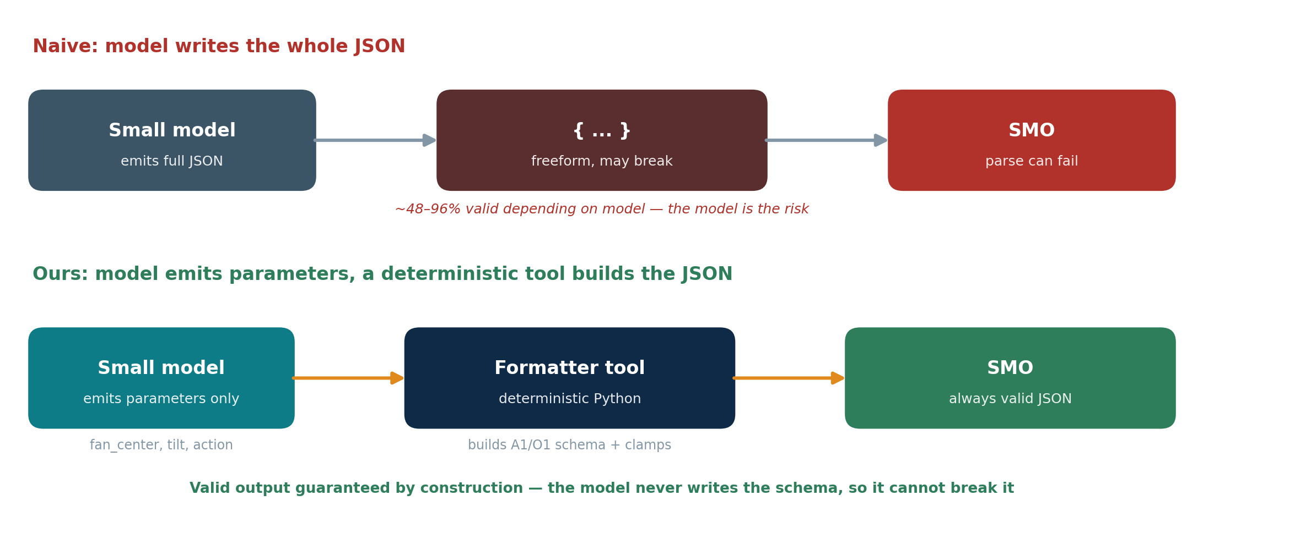
Getting valid JSON
Not model tuning
A tool in front
Directionally an agent
Fine-tuning to fix formatting is slow, costly, and brittle. It treats a design problem as a training problem. We don't reach for it here.
The model emits parameters only — a few numbers. A deterministic Python formatter builds the SMO's exact JSON. The model can't break a schema it never writes.
This is the agent pattern used for correctness: the model decides, deterministic code executes. Wrap it in a validate-and-clamp gate and output is valid by construction.
Net effect: effective success rate is ~100% regardless of the model's raw JSON score. A bad generation falls back to deterministic — never breaks the loop.
6

Slide 15
Role · Skill · Contract · Rules — and where they live
All four are static → set once in the prompt template. One file: src/model.js, function buildPrompt().
ROLE
You are a Non-RT RIC rApp steering a fan of uplink beams to follow a moving crowd.
model.js:16 · pre-loop
CONTRACT (output format)
Return ONLY JSON: fan_center (-49..49), tilt (3..45), action, reason. The model emits numbers only.
model.js:20-24 · pre-loop
RULES (three + tilt)
follow = lead ahead · widen = spread rising + centroid still · allocate = load split.
model.js:37-41 · pre-loop
SKILL (the format task)
Not a prompt instruction — a deterministic tool builds/clamps the JSON. Guaranteed valid.
formatter.js · in-loop tool
TEMPERATURE 0
Greedy decoding — same input, same output. Deterministic beam decisions.
model.js:63 / 91 · per call
The split: role, contract, rules are the static prompt (pre-loop). The skill is the formatter tool, which runs in-loop every tick.
8

Slide 16
The stack
Everything is open source, everything runs on a dual core CPU
Base model
Qwen2.5-0.5B-Instruct
Apache 2.0, 494M params, chat template built in
Install, once
py -m venv .venv
.venv\Scripts\activate
pip install torch
--index-url https://
download.pytorch.org/
whl/cpu
pip install transformers
peft datasets accelerate
Adapter method
LoRA via HuggingFace peft
Only 1-2% params train, adapter is tens of MB
Runtime
PyTorch 2.x, CPU wheel
No GPU, no bitsandbytes, no cloud API
Trainer
transformers.Trainer
use_cpu=True, fp32, standard causal LM loop
Data
datasets.Dataset.from_list
Tick JSONs -> chat examples -> tokenized
Output
adapter_model.safetensors
Load on top of base model at inference
Path 2 delta: add bitsandbytes, swap MODEL_NAME to nvidia/Nemotron Nano 4B, device_map=auto

Slide 17
What we proved
Five problems in agentic network operations, addressed by one 35 MB file
PROBLEM
BEFORE
AFTER THIS RUN
Cost of skills
Full fine-tune per task = $M and weeks. Frontier API call per decision = $ per resolved incident.
35 MB adapter per task. Trained on a laptop, free. Cost per new skill drops 3-4 orders of magnitude.
Sovereignty
Fine-tuning meant shipping training data to a hyperscaler GPU cluster. Non-starter for regulated networks.
Full training loop runs on-prem, on commodity hardware. No data leaves the box. Adapter artifact never touches cloud.
Per-tenant customization
One shared model, one shared behavior. Per-tenant tuning was bespoke engineering.
Same base model in RAM, one lightweight adapter per tenant. Swap in milliseconds. SaaS multi-tenancy for model behavior.
Safety and audit
LLM outputs are opaque, non-deterministic, drift across releases. Hard to certify for TMF Level 4.
Adapter proposes structured JSON. Python policy engine validates and gates every commit. Versioned, signable, rollback-able.
Operating model
The industry ships demos. Executives push back with 'how does this become a product?'
Base = commodity. Skills = versioned adapters on a shelf. Runtime = generic server. Safety = deterministic wrapper. Shippable.
Unit economics that make agentic network operations a product line, not a research demo.

Slide 19
Engineering practice
Right-size the model. Don't reach for a frontier LLM by default.
A small task-tuned model, served locally, is often the right tool for a POC. Faster, cheaper, private, and good enough. This is the pattern and the vocabulary for doing it well.
Proven on the crowd-following beam rApp
0.5B
~9M
4-bit
~0.7s
$0
base model params
trained (LoRA), 1.75%
quantized for serving
warm CPU inference, was ~4.6s
token cost, fully local
Sireen Malik | Autonomous Networks

Slide 20
When a small model is the right call
Match the model to the task, not to the hype. Most POC tasks are narrow and structured.
Reach for a small task-tuned model when
Reserve a frontier model for
+
The task is narrow and well-defined (one skill, fixed schema)
•
Open-ended reasoning over novel, unseen situations
+
Output is structured (JSON, classification, extraction, routing)
•
Broad world knowledge or long-context synthesis
+
You need low latency in a control or edge loop
•
Multi-domain correlation the small model was never trained on
+
Cost per call must be near zero at high volume
•
The hard cases a tiered system escalates to
+
Data must stay on-prem or on-device (sovereign, private)
+
You want deterministic, repeatable behavior you can gate
The pattern: tiered inference. Small task-tuned models carry the high-frequency structured work; frontier models handle the long tail of novel reasoning. Route by task, not by default.
+
It is a POC and you need to move fast on cheap hardware

Slide 21
The vocabulary, said the way the industry says it
So the team speaks the same language as the papers, the model cards, and the tooling.
Base / foundation model
Merge
The pretrained model you start from. Frozen. Example: Qwen2.5-0.5B-Instruct.
Fold the adapter into the base weights: W + (B·A)·(alpha/r). Produces one self-contained model. Structural, not lossy.
Fine-tuning
Quantization
Adapting a base model to a task by training on task data. Full fine-tuning updates all weights.
Store weights at lower precision (FP32 → 4-bit). ~8x smaller, much faster. GGUF is the file format; q4_K_M is a common scheme.
PEFT
Parameter-Efficient Fine-Tuning. Train a tiny fraction of parameters instead of all of them.
Inference server
Serves the model over an API. Ollama and vLLM expose OpenAI-compatible endpoints so app code is provider-agnostic.
LoRA adapter
Low-Rank Adaptation. The PEFT method here. Learns two small matrices (A, B) as a side-path; base stays frozen. Ships as a ~35MB adapter, not a new full model.
Tiered inference
Small tuned models for routine structured tasks; frontier models for novel reasoning. Route per task.
Rank (r) and alpha
Multi-LoRA serving
Rank sizes the adapter (r=16 here). Alpha scales its contribution (alpha/r). Higher rank = more capacity, larger adapter.
One base in memory, many adapters swapped per request. The 'adapter library' pattern for many skills on shared infrastructure.

Slide 22
The POC pipeline, end to end
Five steps from a stock base model to a fast, local, task-tuned endpoint. All on a laptop.
1
2
3
4
5
Select base
PEFT / LoRA train
Merge
Quantize (GGUF)
Serve
Pick a small instruct model sized to the task. Qwen2.5-0.5B here.
Train a low-rank adapter on task data. Base frozen, ~1.75% of params updated. Minutes on CPU.
Fold adapter into base: one self-contained model. W + (B·A)·scale.
Convert to GGUF, quantize to 4-bit (q4_K_M). ~8x smaller, much faster.
Register with an inference server (Ollama). OpenAI-compatible endpoint. App points at it, provider-agnostic.
Two artifacts, two stories. Keep the unmerged adapter for the multi-LoRA 'library of skills on one base' pattern (cloud, multi-tenant). Keep the merged + quantized GGUF for the single-skill fast edge deployment. Merged is for serving one skill; unmerged is for swapping many.
Steps 3 and 4 are for speed and packaging; they do not retrain or change what the model learned.

Slide 23
What this means for how we build POCs
1
Default small, escalate deliberately
Start with the smallest model that can do the task. Reach for frontier only when the task genuinely needs open-ended reasoning.
2
LoRA is how we specialize cheaply
One frozen base, a small adapter per use case. Train in minutes, ship ~35MB, no full retrain, no giant GPU bill.
3
Merge + quantize for the fast path
Collapse to one model and drop to 4-bit when you need production latency on modest hardware. Verify quality after quantizing.
4
Provider-agnostic serving
OpenAI-compatible endpoints mean the app never hard-codes a vendor. Swap Nemotron-in-the-cloud for Qwen-on-a-laptop by changing one env var.
5
Local means private and free
On-device inference: no token cost, no data egress, works offline. The unit economics that turn a demo into a product.
Big models are a tool, not a default. Right-sizing is an engineering decision we make on purpose.

Slide 24
What we still owe
Honest gaps between this proof and a production system
1
Accuracy at scale
2
Robustness to novel inputs
GAP
GAP
30 synthetic ticks proved the pipeline. It did not prove skill on real crowd behavior across sectors, weather, and events.
Model learned the synthetic pattern. Radial dispersal, sensor dropouts, and adversarial patterns will look novel.
ASK
ASK
10,000 real ticks from 3 sectors, quarterly refresh cadence, evaluation harness with held-out sets.
Chaos detection features (radial spread, centroid velocity) added to input, plus a novelty router to escalate to the frontier model.
3
End to end safety story
4
TMF Level 4 certification
GAP
GAP
Policy engine exists in ORCA. Not yet integrated with this adapter's output path. No signed audit log yet.
This is enabling infrastructure, not the audited product. TMF IG1253 and IG1326 alignment work still to do.
ASK
ASK
Wire the deterministic policy engine at commit, add per-action audit records to the object store, dry-run for 30 days before live commit.
Map to TMF autonomy levels, run the Level 4 assessment, evidence pack for operator security and compliance reviews.
Closing these gaps is the path from proof of pipeline to shippable rApp.

